Slide 1
Presidential Address:
Does Finance Benefit Society?
-- Luigi Zingales
(2015 AFA Presidential Address)
Topics in QF
Professor: Phil Dybvig
Presenter: Sunny Deng

Slide 2
Abstract
Background
Happening
Solutions
Conclusions

Slide 3
Background
Dissonance: academics’ view of the benefits of finance vastly exceeds societal perception
Questionnaire: 57% disagree that financial innovation boosts economic growth
Some truth in all criticism that we cannot see because we are too embedded in our own world

Slide 4
Why care about dissonance?
Without fraud → dislike; With fraud → rage (E.g. Ebola v.s. George Soros; private return v.s. social contribution)
Lobby in favor of true competitive markets: weakest way
Conflicts of interest is not the exception but the rule
Money spigot going → seek protection from political power → create more popular resentment → radical backlash
Traditional solutions (new regulators) → become a club to consolidate the power of incumbents

Slide 5
New Regulators
Federal Reserve (1933): prevent the kind of bank runs that forced more than 5,000 banks to close in the early 1930s
Securities and Exchange Commission (SEC) (1934): prevent the stock market manipulations that had prevailed during the 1920s
The Office of Thrift Supervision (1989): deal with the savings-and-loan crisis of the late 1980s
Public Company Accounting Oversight Board (PCAOB): in response to the Enron and WorldComm accounting scandals
Consumer Financial Protection Bureau (CFPB): created because of 2007 and 2008 financial crisis

Slide 6
Happening: Hypertrophic financial sector
-- more and more complicated markets in order to win in a competition
Creation and growth of junk bond market, option and futures markets, or OTC derivatives
  Credit to the private sector reaches 80%-100% of GDP, marginal effect of financial depth on output growth becomes negative
With noble excuse to receive government subsidy
Financial sectors provide much greater opportunities for abuse, and even government takes advantage
Fraud: Feature, not Bug

Slide 7
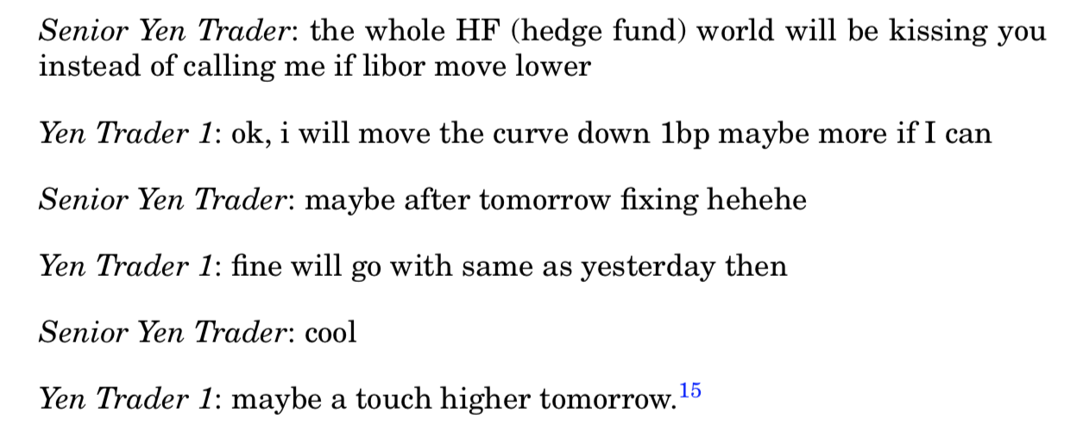
Fraud: Feature, not Bug
15: See http://www.huffingtonpost.co.uk/2013/02/06/libor-scandal-outrageous-traders-exchanges_ n_2630945.html.

Slide 8
Happening: Hypertrophic financial sector
-- more and more complicated markets in order to win in a competition
Duping unsophisticated investors
  E.g.: Lemon securities
  E.g.: Packaged with some optional overpriced add-ones
Innovation efforts take place in searching for better duping opportunities
Financial engineering provides an extremely flexible tool to exploit agency problems
Principals are dispersed with little ability to coordinate a move

Slide 9
Solutions – Empirical research?
Whistleblower – quite difficult
  Data not broadly accessible
  Regulators are risk-averse
  Treating sources favorable in order to obtain data
Ex post cost-benefit analysis – example of payday loans
  Payday loans: a form of regulatory arbitrage around anti-usury laws
  Data: 44% less in interest than in 2009 under the conventional payday loan model, saving $41.9 million
  Facts
    Fewer borrowers declared bankruptcy
    Reduction in the excessive entry

Slide 10
Solutions – Theoretical research!
Rigorous
  More realistic, more relevant
Simple
  Facilitate accountability → reducing lobbying cost and easier for the public to monitor
Not mouthpiece of interest of those political economists
  Political economists: embed the lobbying pressure of powerful incumbents
  Not the forefront of our economic analysis

Slide 11
Solutions – Teaching!
Why pay attention to teaching?
  Prevailing business culture in the banking industry undermines honesty
  Teaching of economics makes students more selfish and less concerned about the common good
Ways to improve
  Not relegate prescriptive analysis or poorly attended ethic courses
  Underscore how violating most social norms has a negative effect on reputation
  Social norms are crucial to the flourishing of a market economy

Slide 12
Paper’s conclusion
Current situations → Gap
  Too proud of the technical achievements and economic successes of our discipline and too complacent of its shortcomings
  Between our self-perception and the outside perception of our role in society
Fill the gap
  Better explain and document the contribution of finance to society
  Appreciate that some of the criticisms that have been raised are well founded
  Guard against the risks of becoming simple mouthpieces of the financial industry
  With rule of law is respected and expected to be respected in the future

Slide 13
Personal thoughts
Motivation of writing this paper
  Professionally analyze the reality aspects
  Give confidence to people who are unfamiliar with this industry
Identifying the realities and problems rooted deeply
Using question marks as titles
Providing enough daily examples, collected data, studies or research results in other papers

Slide 14
Thanks for listening!
Q&A

